Slide 1
Lecture: 2
Spring 2022

Slide 2
Data communications and networking are changing the way we do business and the way
we live.
Business decisions have to be made ever more quickly, and the decision makers
require immediate access to accurate information.
Businesses today rely on computer networks and internetworks.

Slide 3
Why wait a week for that report from Germany to arrive by mail when it could appear almost instantaneously through computer networks?
Some advanced features of cellular phones:
conference calling
call waiting
voice mail
caller ID option

Slide 4
Information sharing can be
local - Between individuals, local communication usually occurs face to face
remote - communication takes place over distance.
The term telecommunication, which includes telephony, telegraphy, and television,means communication at a distance (tele is Greek for "far").

Slide 5
The word data refers to information presented in whatever form is agreed upon by the parties creating and using the data.
Data communications are the exchange of data between two devices via some form of transmission medium such as a wire cable.
For data communications to occur, the communicating devices must be part of a communication system made up of a combination of hardware (physical equipment) and software (programs).

Slide 6
The effectiveness of a data communications system depends on four fundamental characteristics:
Delivery
Accuracy
Timeliness
Jitter

Slide 7
Delivery
The system must deliver data to the correct destination. Data must be received by the intended device or user and only by that device or user.

Slide 8
Accuracy
The system must deliver the data accurately. Data that have been altered in transmission and left uncorrected are unusable.

Slide 9
Timeliness
The system must deliver data in a timely manner. Data delivered late are useless. In the case of video and audio, timely delivery means delivering data as they are produced, in the same order that they are produced, and without significant delay. This kind of delivery is called real-time transmission.

Slide 10
Jitter
Jitter refers to the variation in the packet arrival time. It is the uneven delay in the delivery of audio or video packets.

Slide 11
A data communications system has five components:

Slide 12
Message
The message is the information (data) to be communicated.
Popular forms of information include text, numbers, pictures, audio, and video.

Slide 13
Sender
The sender is the device that sends the data message. It can be a computer, workstation, telephone handset, video camera, and so on.

Slide 14
Receiver
The receiver is the device that receives the message. It can be a computer, workstation, telephone handset, television, and so on.

Slide 15
Transmission medium
The transmission medium is the physical path by which a message travels from sender to receiver. Some examples of transmission media include twisted-pair wire, coaxial cable, fiber-optic cable, and radio waves.

Slide 16
Protocol
A protocol is a set of rules that govern data communications. It represents an agreement between the communicating devices. Without a protocol, two devices may be connected but not communicating, just as a person speaking French cannot be understood by a person who speaks only Japanese.

Slide 17
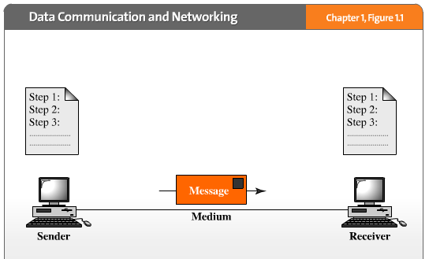
protocol
protocol

Slide 19
Data Representation
Information today comes in different forms such as text, numbers, images, audio, and
video.

Slide 20
Text
In data communications, text is represented as a bit pattern, a sequence of bits (0s or 1s). Different sets of bit patterns have been designed to represent text symbols. Each set is called a code, and the process of representing symbols is called coding.

Slide 21
Numbers
Numbers are also represented by bit patterns. However, a code such as ASCII is not used
to represent numbers; the number is directly converted to a binary number to simplify
mathematical operations.

Slide 22
Images
Images are also represented by bit patterns. In its simplest form, an image is composed
of a matrix of pixels (picture elements), where each pixel is a small dot. The size of the pixel depends on the resolution. For example, an image can be divided into 1000 pixels or 10,000 pixels. In the second case, there is a better representation of the image (better resolution), but more memory is needed to store the image.

Slide 23
Audio
Audio refers to the recording or broadcasting of sound or music. Audio is by nature different from text, numbers, or images. It is continuous, not discrete. Even when we use a microphone to change voice or music to an electric signal, we create a continuous signal.

Slide 24
Video
Video refers to the recording or broadcasting of a picture or movie. Video can either be
produced as a continuous entity (e.g., by a TV camera), or it can be a combination of images, each a discrete entity, arranged to convey the idea of motion.

Slide 25
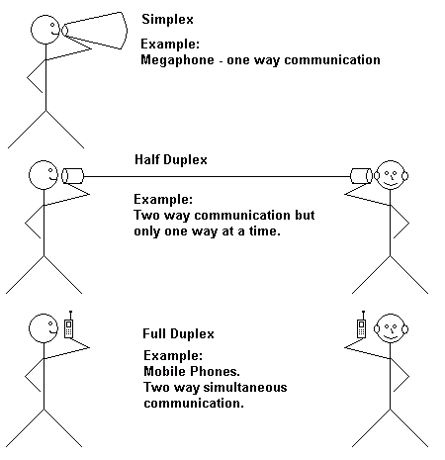
Data Flow Communication between two devices can be simplex, half-duplex, or full-duplex as shown in Figure

Slide 26
Simplex
In simplex mode, the communication is unidirectional, as on a one-way street. Only one of the two devices on a link can transmit; the other can only receive.
Keyboards and traditional monitors are examples of simplex devices. The keyboard can only introduce input; the monitor can only accept output.
The simplex mode can use the entire capacity of the channel to send data in one direction.

Slide 27
Half-Duplex
In half-duplex mode, each station can both transmit and receive, but not at the same time. When one device is sending, the other can only receive, and vice versa.
The half-duplex mode is like a one-lane road with traffic allowed in both directions. When cars are travelling in one direction, cars going the other way must wait.

Slide 28
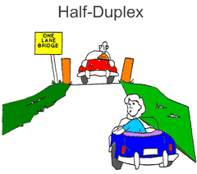

Slide 29
In a half-duplex transmission, the entire capacity of a channel is taken over by whichever of the two devices is transmitting at the time.
Walkie-talkies and CB (citizens band) radios
are both half-duplex systems.
The half-duplex mode is used in cases where there is no need for communication in both directions at the same time; the entire capacity of the channel can be utilized for
each direction.

Slide 30
Full-Duplex
In full-duplex mode (also called duplex), both stations can transmit and receive simultaneously.
The full-duplex mode is like a two-way street with traffic flowing in both directions at the same time.

Slide 31
In full-duplex mode, signals going in one direction share the capacity of the link: with signals going in the other direction.
This sharing can occur in two ways:
The link must contain two physically separate transmission paths, one for sending and the other for receiving;
The capacity of the channel is divided between signals travelling in both directions.

Slide 32
One common example of full-duplex communication is the telephone network.
When two people are communicating by a telephone line, both can talk and listen at the
same time.

Slide 33
A network must be able to meet a certain number of criteria. The most important of
these are :
performance
reliability
security.

Slide 34
Performance
Performance can be measured in many ways, including transit time and response time.
Transit time is the amount of time required for a message to travel from one device to another.
Response time is the elapsed time between an inquiry and a response.
The performance of a network depends on a number of factors, including the number of users, the type of transmission medium, the capabilities of the connected hardware, and the
efficiency of the software.

Slide 35
Performance is often evaluated by two networking metrics: throughput and delay.
We often need more throughput and less delay. However, these two criteria are often
contradictory.
If we try to send more data to the network, we may increase throughput
but we increase the delay because of traffic congestion in the network.

Slide 36
Reliability
In addition to accuracy of delivery, network reliability is measured by the frequency of
failure, the time it takes a link to recover from a failure, and the network's robustness in
a catastrophe.

Slide 37
Security
Network security issues include protecting data from unauthorized access, protecting
data from damage and development, and implementing policies and procedures for
recovery from breaches and data losses.

Slide 38
Performance VS Security VS Reliability

